Slide 1
CUDA Advanced Libraries
Thrust Data Reduction

Slide 2
Thrust Data Reduction
Take a device_vector and an interval over that device_vector
Create a single value by performing the same operation “between” values in interval
With V as Vector of size 2
Reduction operation is plus
int result = V[0] + V[2]
[1]

Slide 3

Reduction Syntax
Syntax generally is arguments
0 – begin index
1 – end index
2 – initial value
3 – operation
Using plus is so common it is the default, so the below operations are the same.

Slide 4
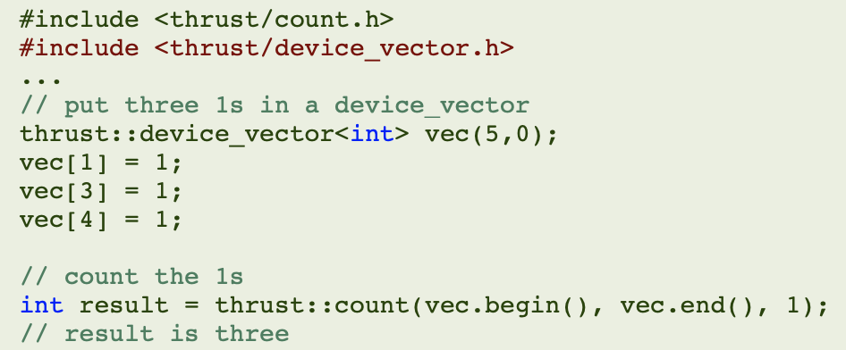
Special Reduction Types
count, min_element, max_element, is_sorted, inner_product, etc.

Slide 5
References
[1] 2021. NVIDIA. CUDA Developer Toolkit Documentation – Thrust Library. Found at https://docs.nvidia.com/cuda/thrust/index.html.

